Slide 1
How does the Foot and Lower Limb Dissipate Impact Energy at Heel Strike?
Neil Poulton

Slide 2
Family and Physio

Slide 3
Crazy

Slide 4
Obsessive

Slide 5
Cyclist

Slide 6
How does the Foot and Lower Limb Dissipate Impact Energy at Heel Strike?

Slide 7
Dissipating Force at Heel Strike
Passive Structures
Dynamic
Fat Pad
Menisci
Labrum
Land inverted, triggering pronation
Cascade of movement
Fat Pad
Triggers Bone Motions
Menisci and Labrum
Creates Joint Motion
Fires Muscle Action

Slide 8
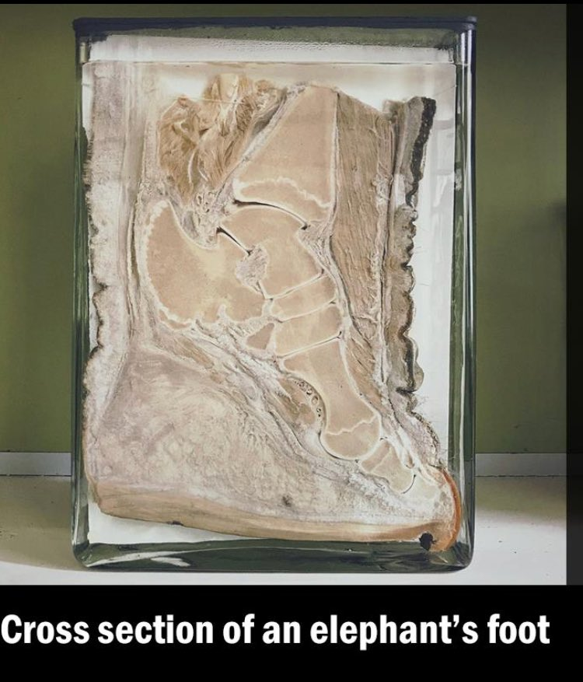
Plantar Fat Pad
The plantar fat pad of the heel:
Fibro-adipose structure
Protection against the peak bone stresses
Kelly et al. (2018)
Can absorb between 20-50% of applied impact forces, Wearing et al. (2014)

Slide 9
Menisci and Labrum
Multiple functions:
Fibro cartilage and collagenous connective tissue structure can act as shock absorber.
Increase joint congruity, increasing contact area, lowering peak bone stress.
Magee et al. (2007)

Slide 10
Dissipating Force at Heel Strike
Passive Structures
Dynamic
Fat Pad
Menisci
Labrum
Land inverted, triggering pronation
Cascade of movement
Fat Pad
Triggers Bone Motions
Menisci and Labrum
Creates Joint Motion
Fires Muscle Action

Slide 11
Dynamic
Landing inverted helps trigger cascade of bone motions, Joint Feelings and Muscle Reactions:
Joint | Sagittal | Frontal | Transverse
Sub Talar Joint | Dorsiflexion | Eversion | External Rotation
Knee | Flexion | Abduction | Internal Rotation
Hip | Flexion | Adduction | Internal Rotation
Hardy et al. 2008

Slide 12
Dynamic
This chain of motion allows the ground reaction force to load the soft tissues in all 3 planes.
Though some forces are dissipated, energy storage for use later in the movement is also a key element.

Slide 13
References
Kelly, L.A., Cresswell, A.G. and Farris, D.J. (2018) 'The energetic behaviour of the human foot across a range of running speeds', Scientific reports, 8(1), pp. 10576-1.
Magee, D.J., Zachazewski, J.E. and Quillen, W.S. (2007) ‘Scientific Foundations and Principles of Practise in Musculoskeletal Rehabilitation. Elselvier.
Wearing, S.C., Hooper, S.L., Dubois, P., Smeathers, J.E. and Dietze, A. (2014) 'Force-deformation properties of the human heel pad during barefoot walking', Medicine and science in sports and exercise, 46(8), pp. 1588-1594.

